Slide 1
Brunel Buy and Sell
Android Application User Interface
Group 15

Slide 2
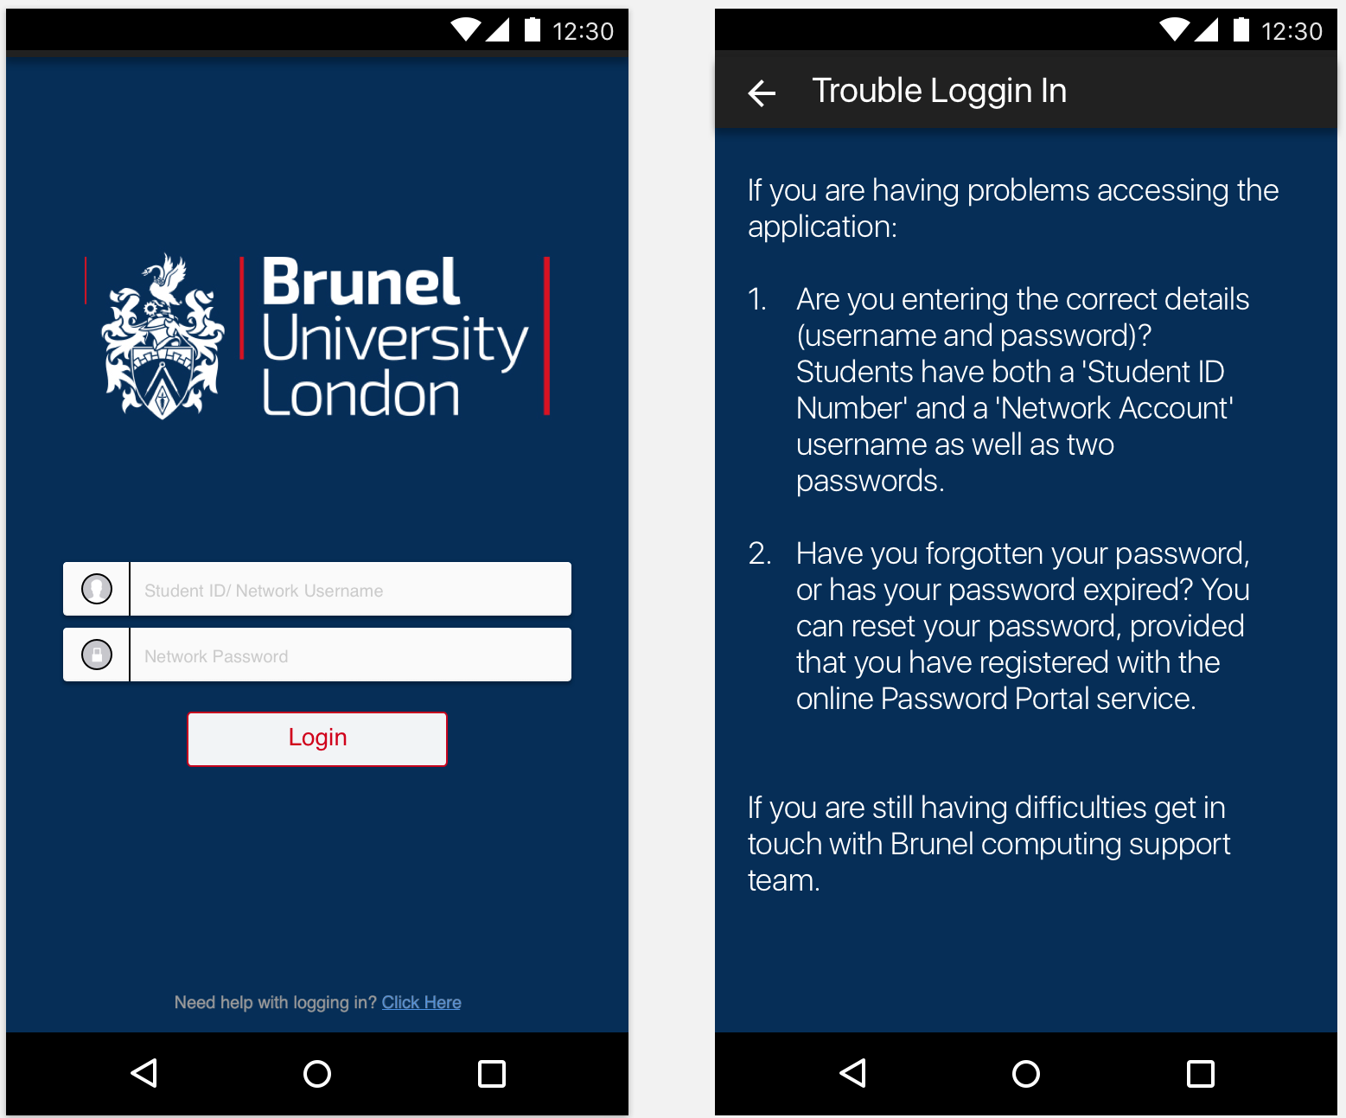
Login / Login Help Screen

Slide 3
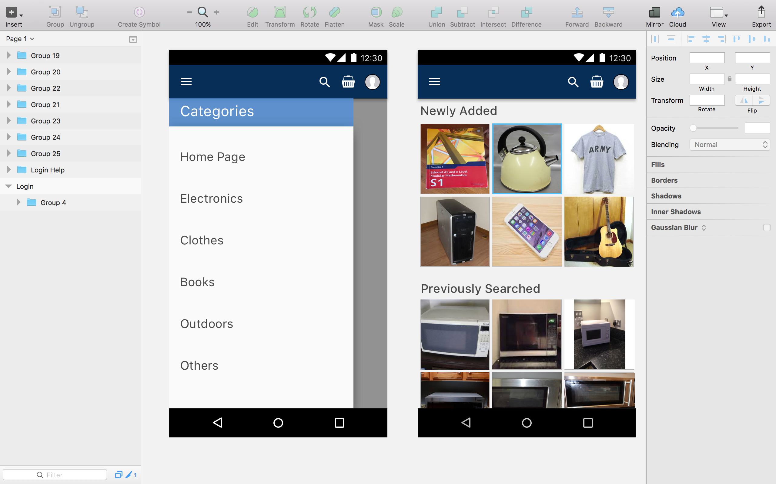
Home Page Screen

Slide 4
Category Bar

Slide 5
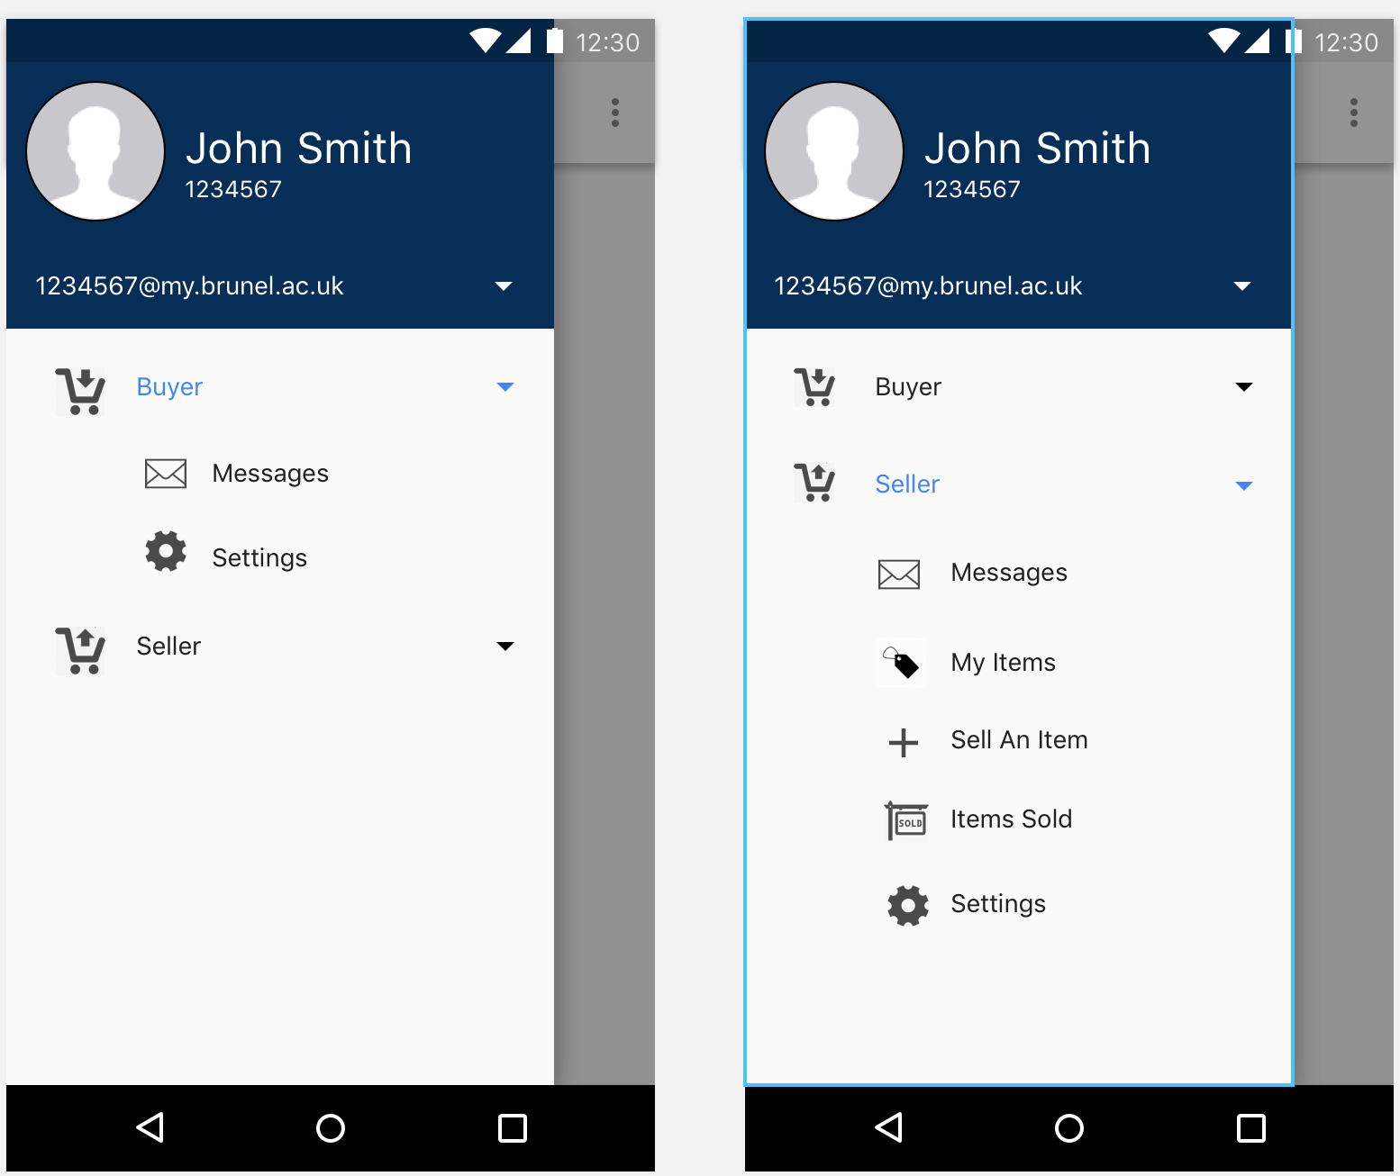
Buyer/ Seller Interface

Slide 6
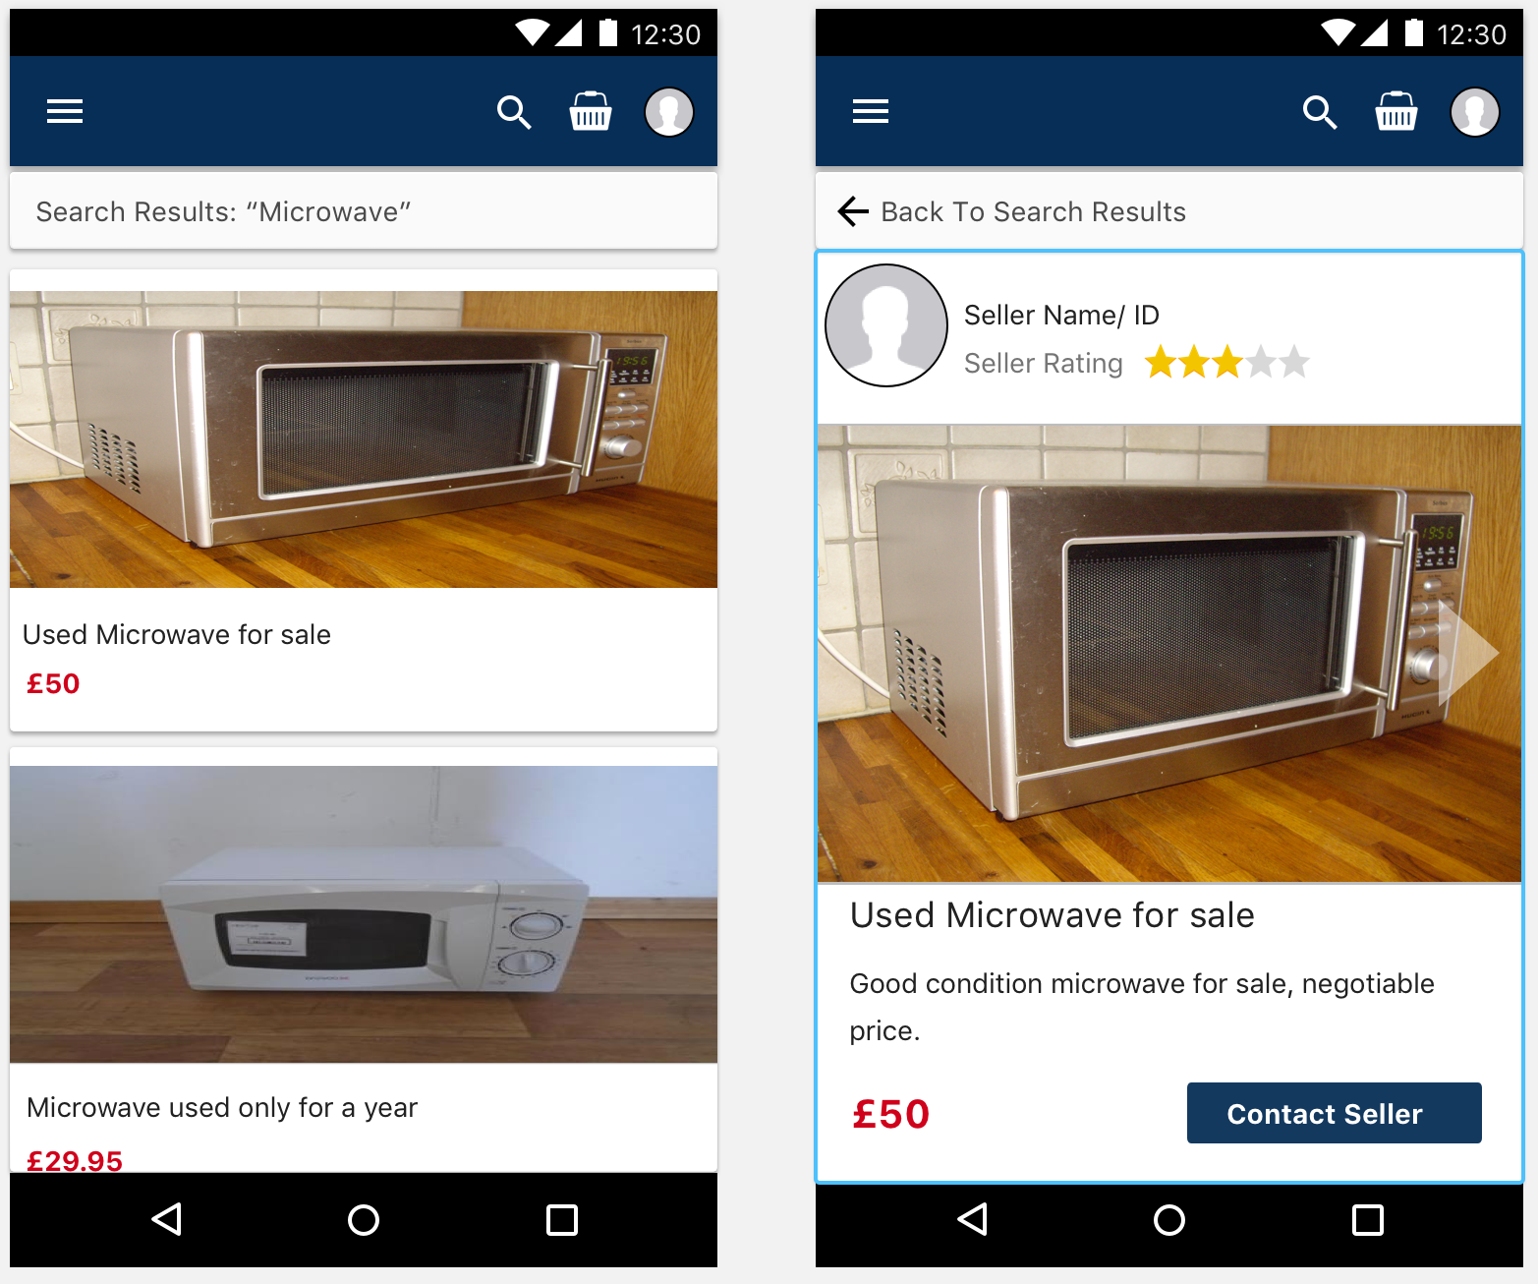
Product Information

Slide 7
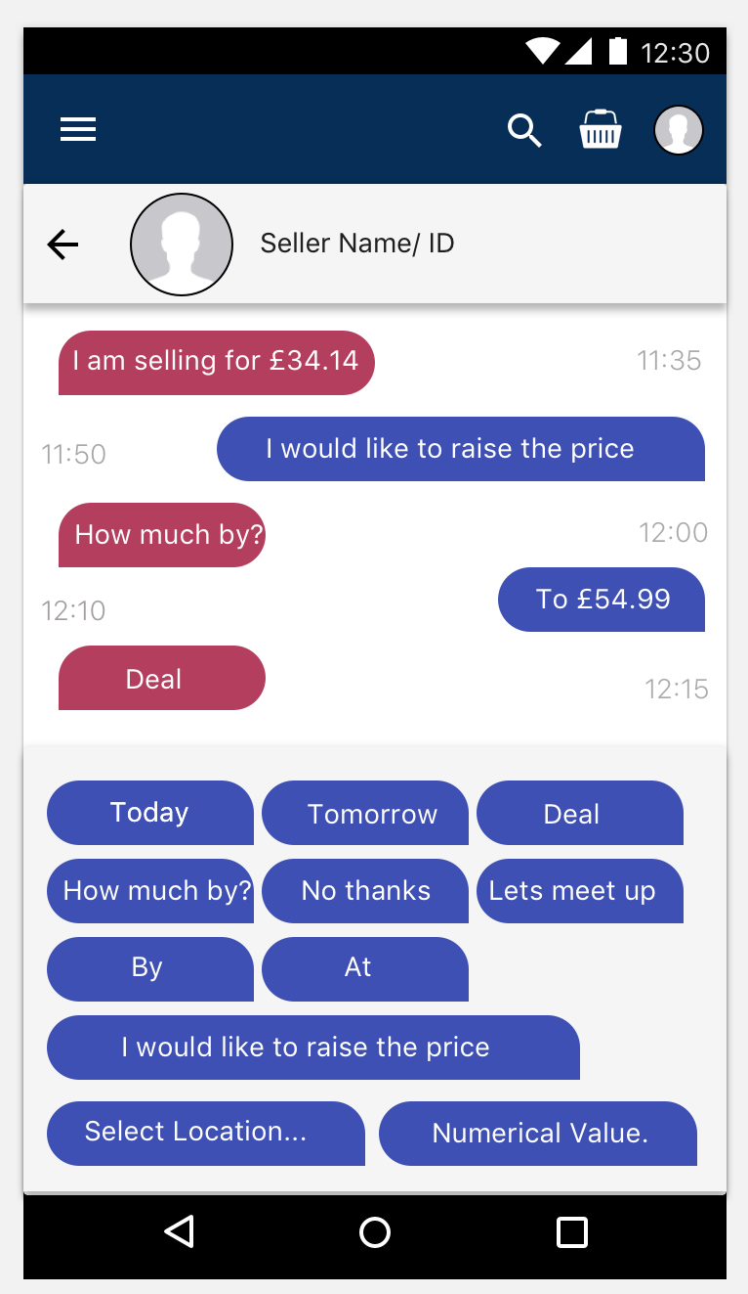
Buyer/Seller Messaging

